Slide 1
Facility Resource Emergency Database (FRED)
Easy Operating Guide

Slide 2
Go to the following website:
http://www.miemss.org/alert

Slide 3
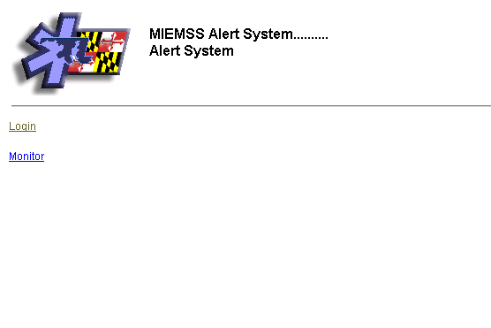
To Monitor FRED:
Click Here

Slide 4
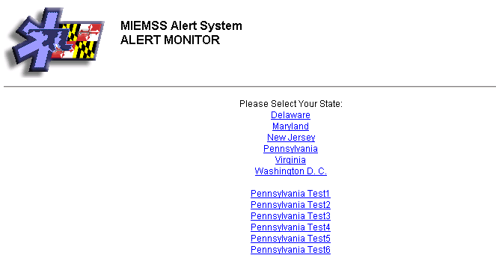
Select State (Pennsylvania)
Click Here

Slide 5
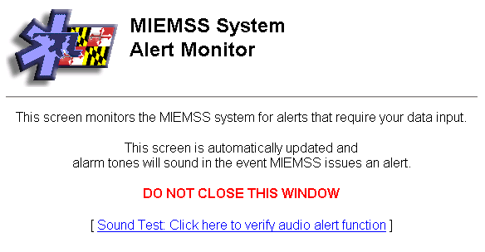
Keep this Window OPEN
(click on to minimize to task bar)
_

Slide 6
To Enter Data on FRED
(FIRST: click on FRED icon on Task Bar)
Click Here

Slide 7
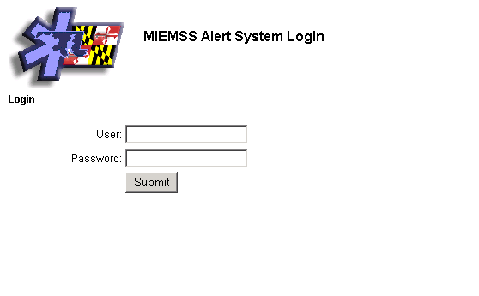
Enter User Name & Password
Click Here to Submit

Slide 8
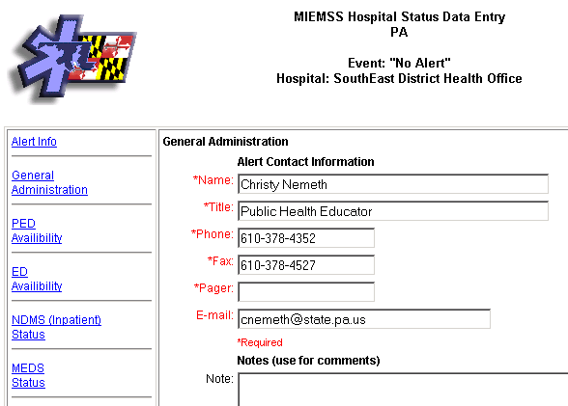
Enter all Required (RED) Information

Slide 9
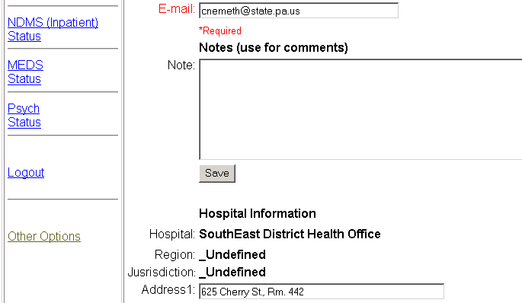
Click if any information changed
Save
Click Here

Slide 10
Click on Link to enter specific information
Click Here to enter ED Bed Status

Slide 11
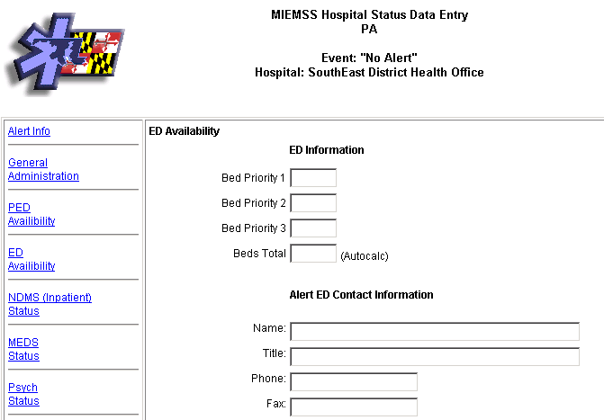
Enter Current Bed Status & Information

Slide 12
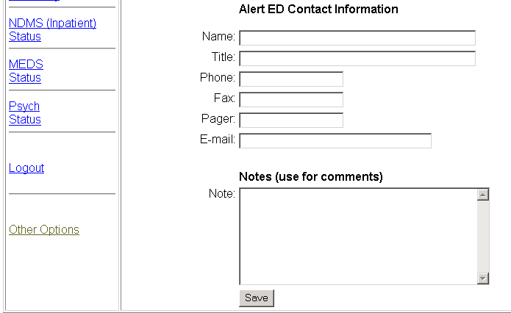
Click to Enter Status
Save
Click Here

Slide 13
Enter other data as requested
(follow the same procedure)
Click Here to enter other bed status

Slide 14
Don’t forget to click
Save
Click Here

Slide 15
Questions?
Please contact the EMS Regional Council for your area.
Or contact Marty Singer, PA DOH Hospital Bioterrorism Preparedness Coordinator at: marsinger@state.pa.us

